Slide 1
The Best Security Innovation of 2009
Ksplice
By
Yang Huang (Chloe), Minh Tuan Pascal Nguyen and Yifan Mei (Sam)
Group 15
29/10/2009

Slide 2

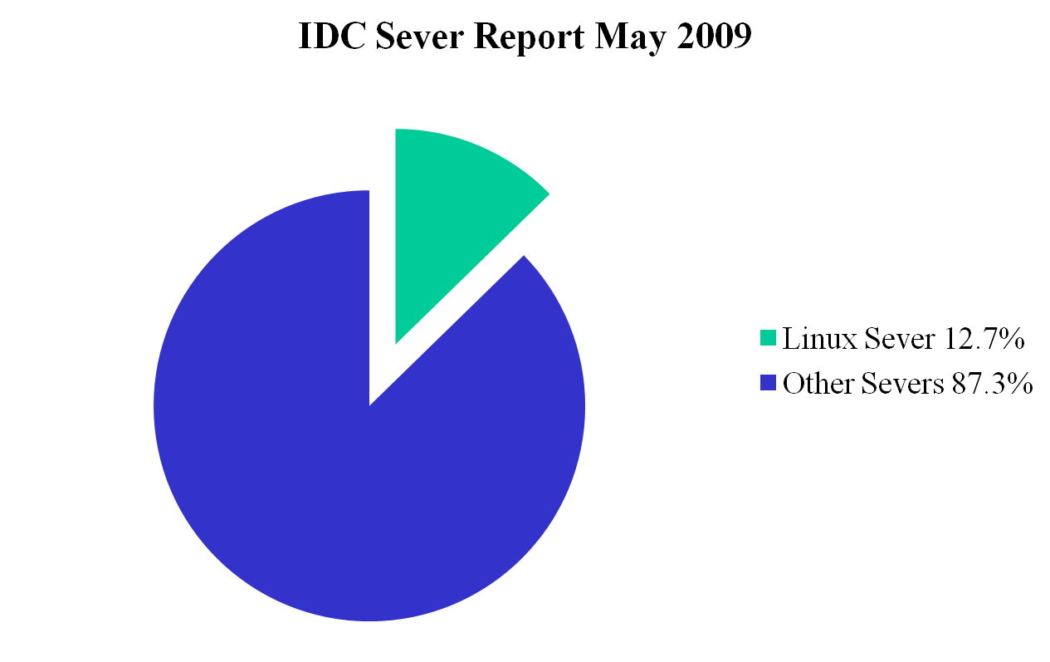
Proportion of Linux Sever in the market

Slide 3
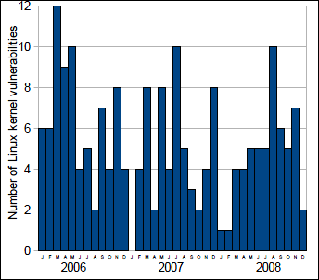
Vulnerabilities/Time Graph

Slide 4
What is Ksplice?
Ksplice Uptrack is an update management solution that lets you effortlessly keep your Linux infrastructure up to date with the latest important security and reliability updates.
Ksplice streamlines software updates by eliminating the need for disruptive reboots, reducing maintenance costs and increasing system dependability.

Slide 5
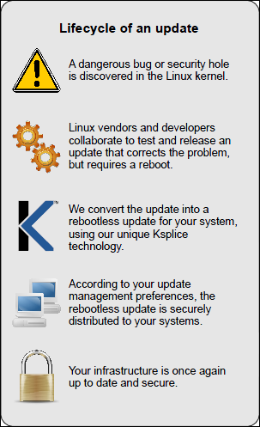

Slide 6
Quotes
“Ksplice is truly first class. … One day in the future when Ksplice becomes the norm, we’ll look back and wonder what we ever used to do.”
    —Christopher Smart, Linux Magazine
I run busy servers and Ksplice has increased uptime and decreased my ‘worry time’. I don’t have to get up at 3 a.m. to make major changes. How great is that!
    —Michael Alft, Alft&Wilson Publishing

Slide 7
How Hot is Ksplice
Check the update patch change the Data structure or not /A programmer write new codes
Ksplice is designed to update legacy binaries
Ksplice does not require any preparation before update
Ksplice performs replacements on entire functions

Slide 8
How does Ksplice work?
Ksplice uses pre-post differencing to generate object code for the update
Ksplice resolves symbols correctly and provides safety using run-pre matching

Slide 9
Pre-Post Difference
Ksplice compares the kernel’s binary code:
Before applying the patch (pre)
After applying the patch (post)

Slide 10
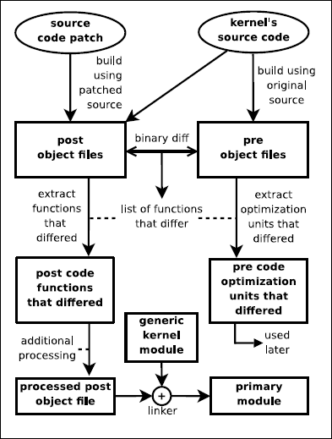
Generating replacement code based on a patch

Slide 11
Avoid big differences
Avoid extraneous differences for practicality.
Be able to generate object code that makes no assumptions about where functions are stored.
Important for creating the replacement code, this then references existing functions.
Certain compiler options are enabled to reduce location assumptions.

Slide 12
What happens after?
Ksplice extracts the changed functions from the post object.
Puts them into their own object file
Ksplice creates a kernel module called primary module that will load processed post code into the kernel.
Last step before the file can be used…

Slide 13
Safety verification
when a hot update system makes unchecked assumptions about the run code
Ksplice detects all differences between the pre code and the post code
adding a step to the hot update process to check the run code against the pre code

Slide 14
Run-Pre Matching
Run-Pre Matching technique is used to address the following challenges:
How to resolve symbols in the replacement code
How to verify the safety of an update

Slide 15
Hot update
run-pre check will be safe if:
  using exactly the same compiler version
  assembler version
  compiler options

Slide 16
Operating of run-pre matching
matching system must be able to recognize no-op instruction sequences
must know basic information about the instruction set

Slide 17
Stackholders
Common Linux users:
  Less distruption while working.
System Adminstrators:
  No more downtime.
  No more loss of state (eg network connections).
  No more unexpected complications.
Cybercriminals:
  Exploit known vulnerablities if system not updated.

Slide 18
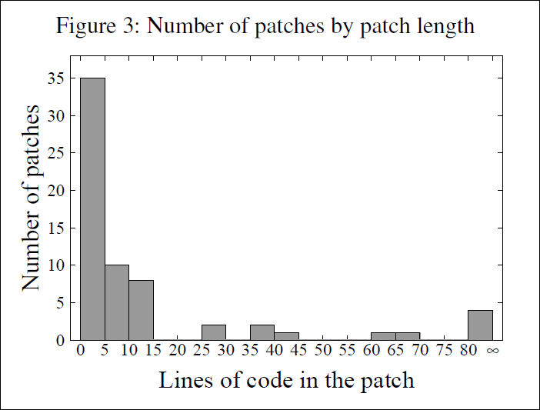
Evaluation

Slide 19
Evaluation(continue)
Most Linux kernel security vulnerabilities can be corrected by modifying relatively few lines of source code. Of the 64 vulnerabilities from this time interval, 53 vulnerabilities were corrected in 15 or fewer lines of source code changes, and 35 vulnerabilities were corrected in 5 or fewer lines of changes.

Slide 20
Conclusion
No advance preparation required
Virtualization-ready
No negative performance impact
Rollback capability

Slide 21
Top awards for Ksplice
The Wall Street Journal named Ksplice the gest security innovation of 2009
The Global Security Challenge declared Ksplice the winner of its 2009 Global Cybersecurity Challenge
The Trophees du Libre international software competition named Ksplice the best security software of 2009 and awarded Ksplice a special prize.
In 2009, Ksplice became the first software product to win the Massachusetts Institute of Technology $100K competition in more than 10 years.

Slide 22
Reference
http://www.ksplice.com/
http://www.ksplice.com/uptrack/
http://www.ksplice.com/uptrack/howitworks
http://www.ksplice.com/uptrack/faq
http://www.ksplice.com/doc/ksplice-brochure.pdf
http://www.ksplice.com/doc/ksplice.pdf

Slide 23
Thanks for Listening!

